Slide 1
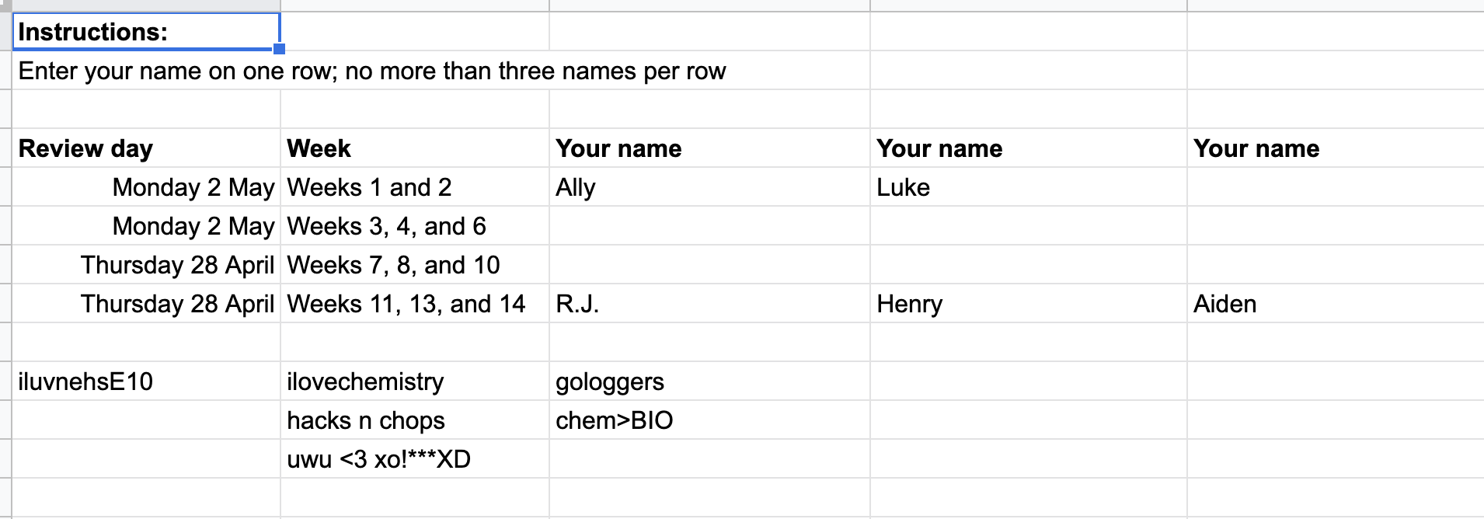
Sign-up for the review

Slide 2
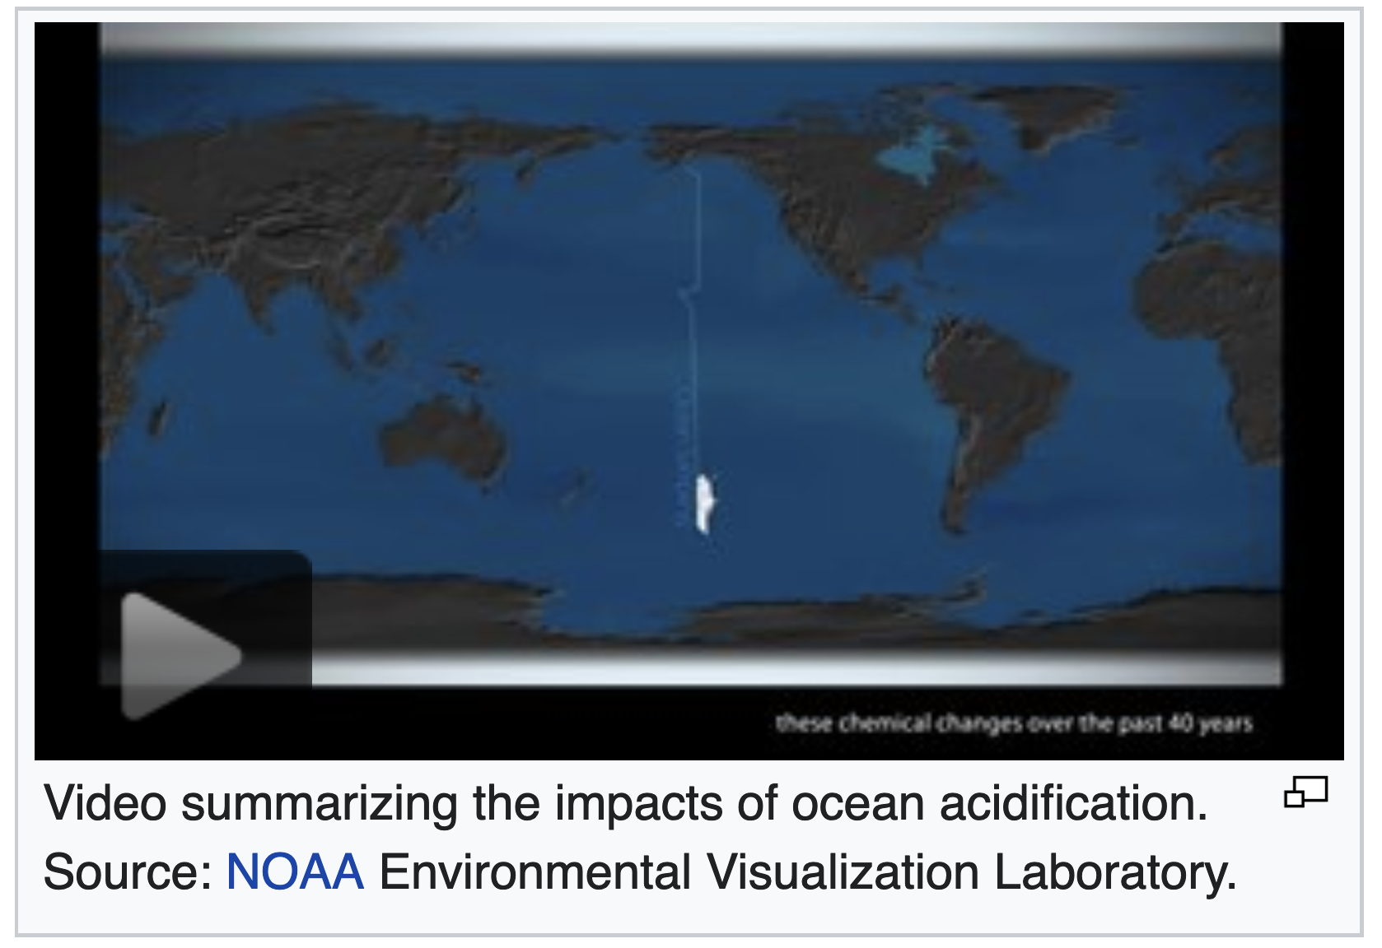
Introduction to ocean acidification
https://en.wikipedia.org/wiki/Ocean_acidification

Slide 3
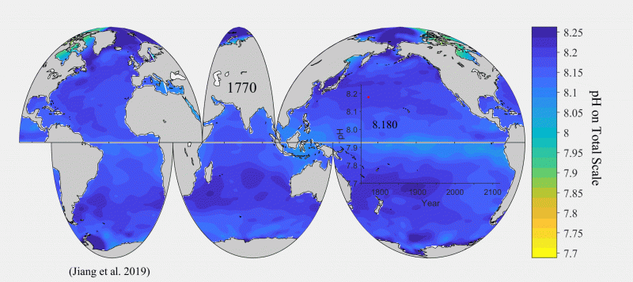
Ocean pH varies according to where (and when) you are
https://toolkit.climate.gov/sites/default/files/Surface_pH_1770_2100_1s.gif

Slide 4
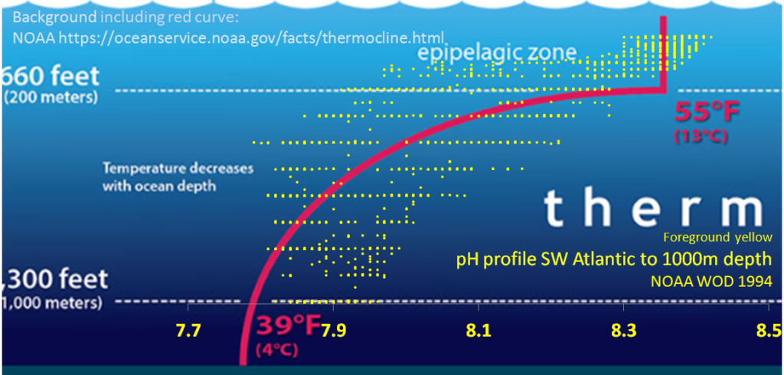
Ocean pH also varies with depth

Slide 5
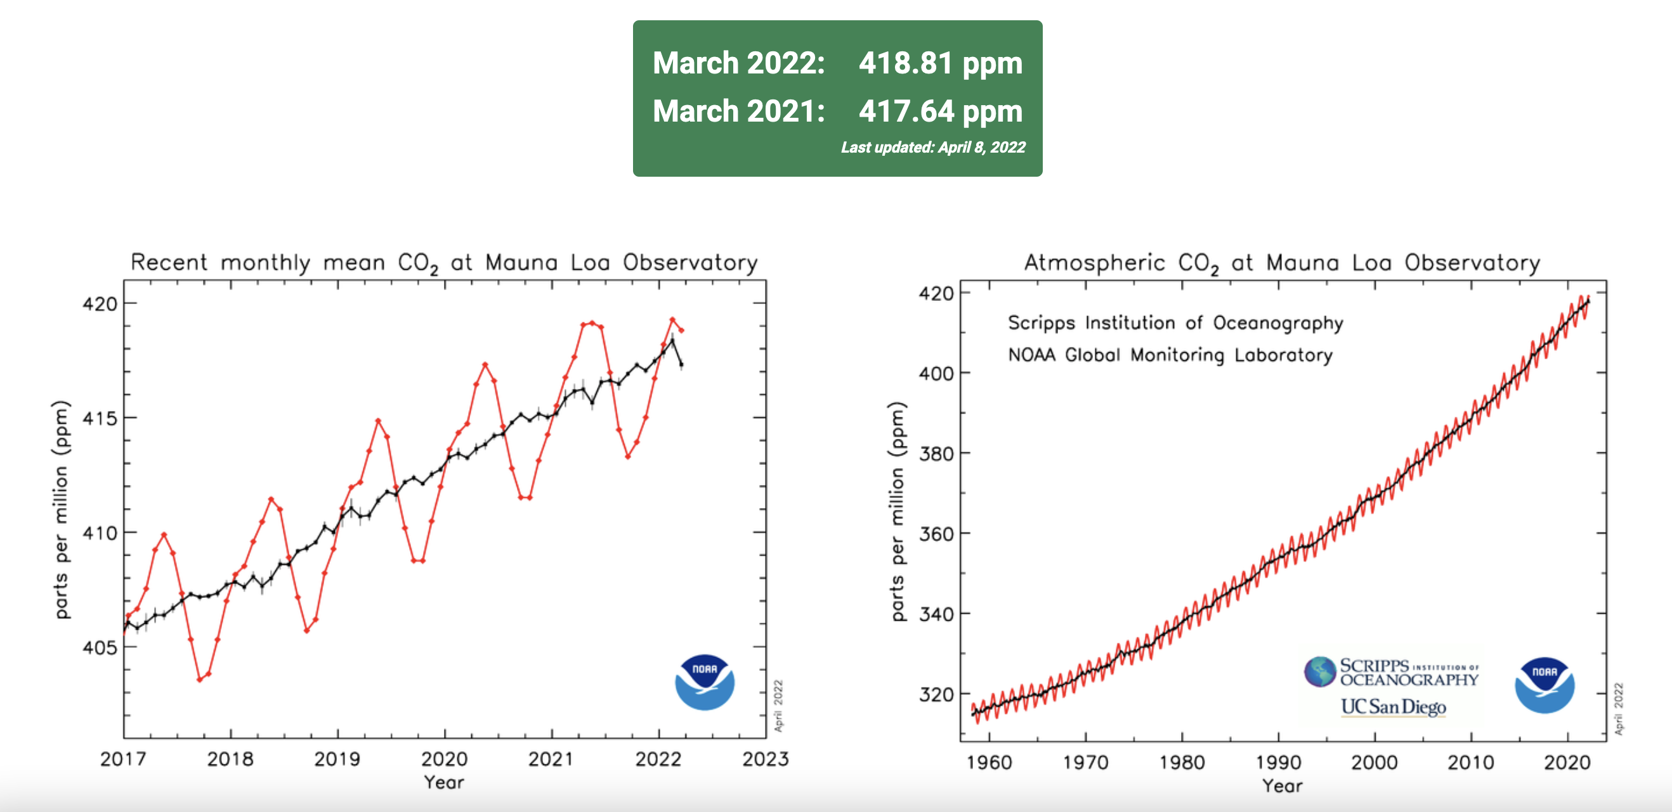
Atmospheric CO₂ measurements at Mauna Loa

Slide 6
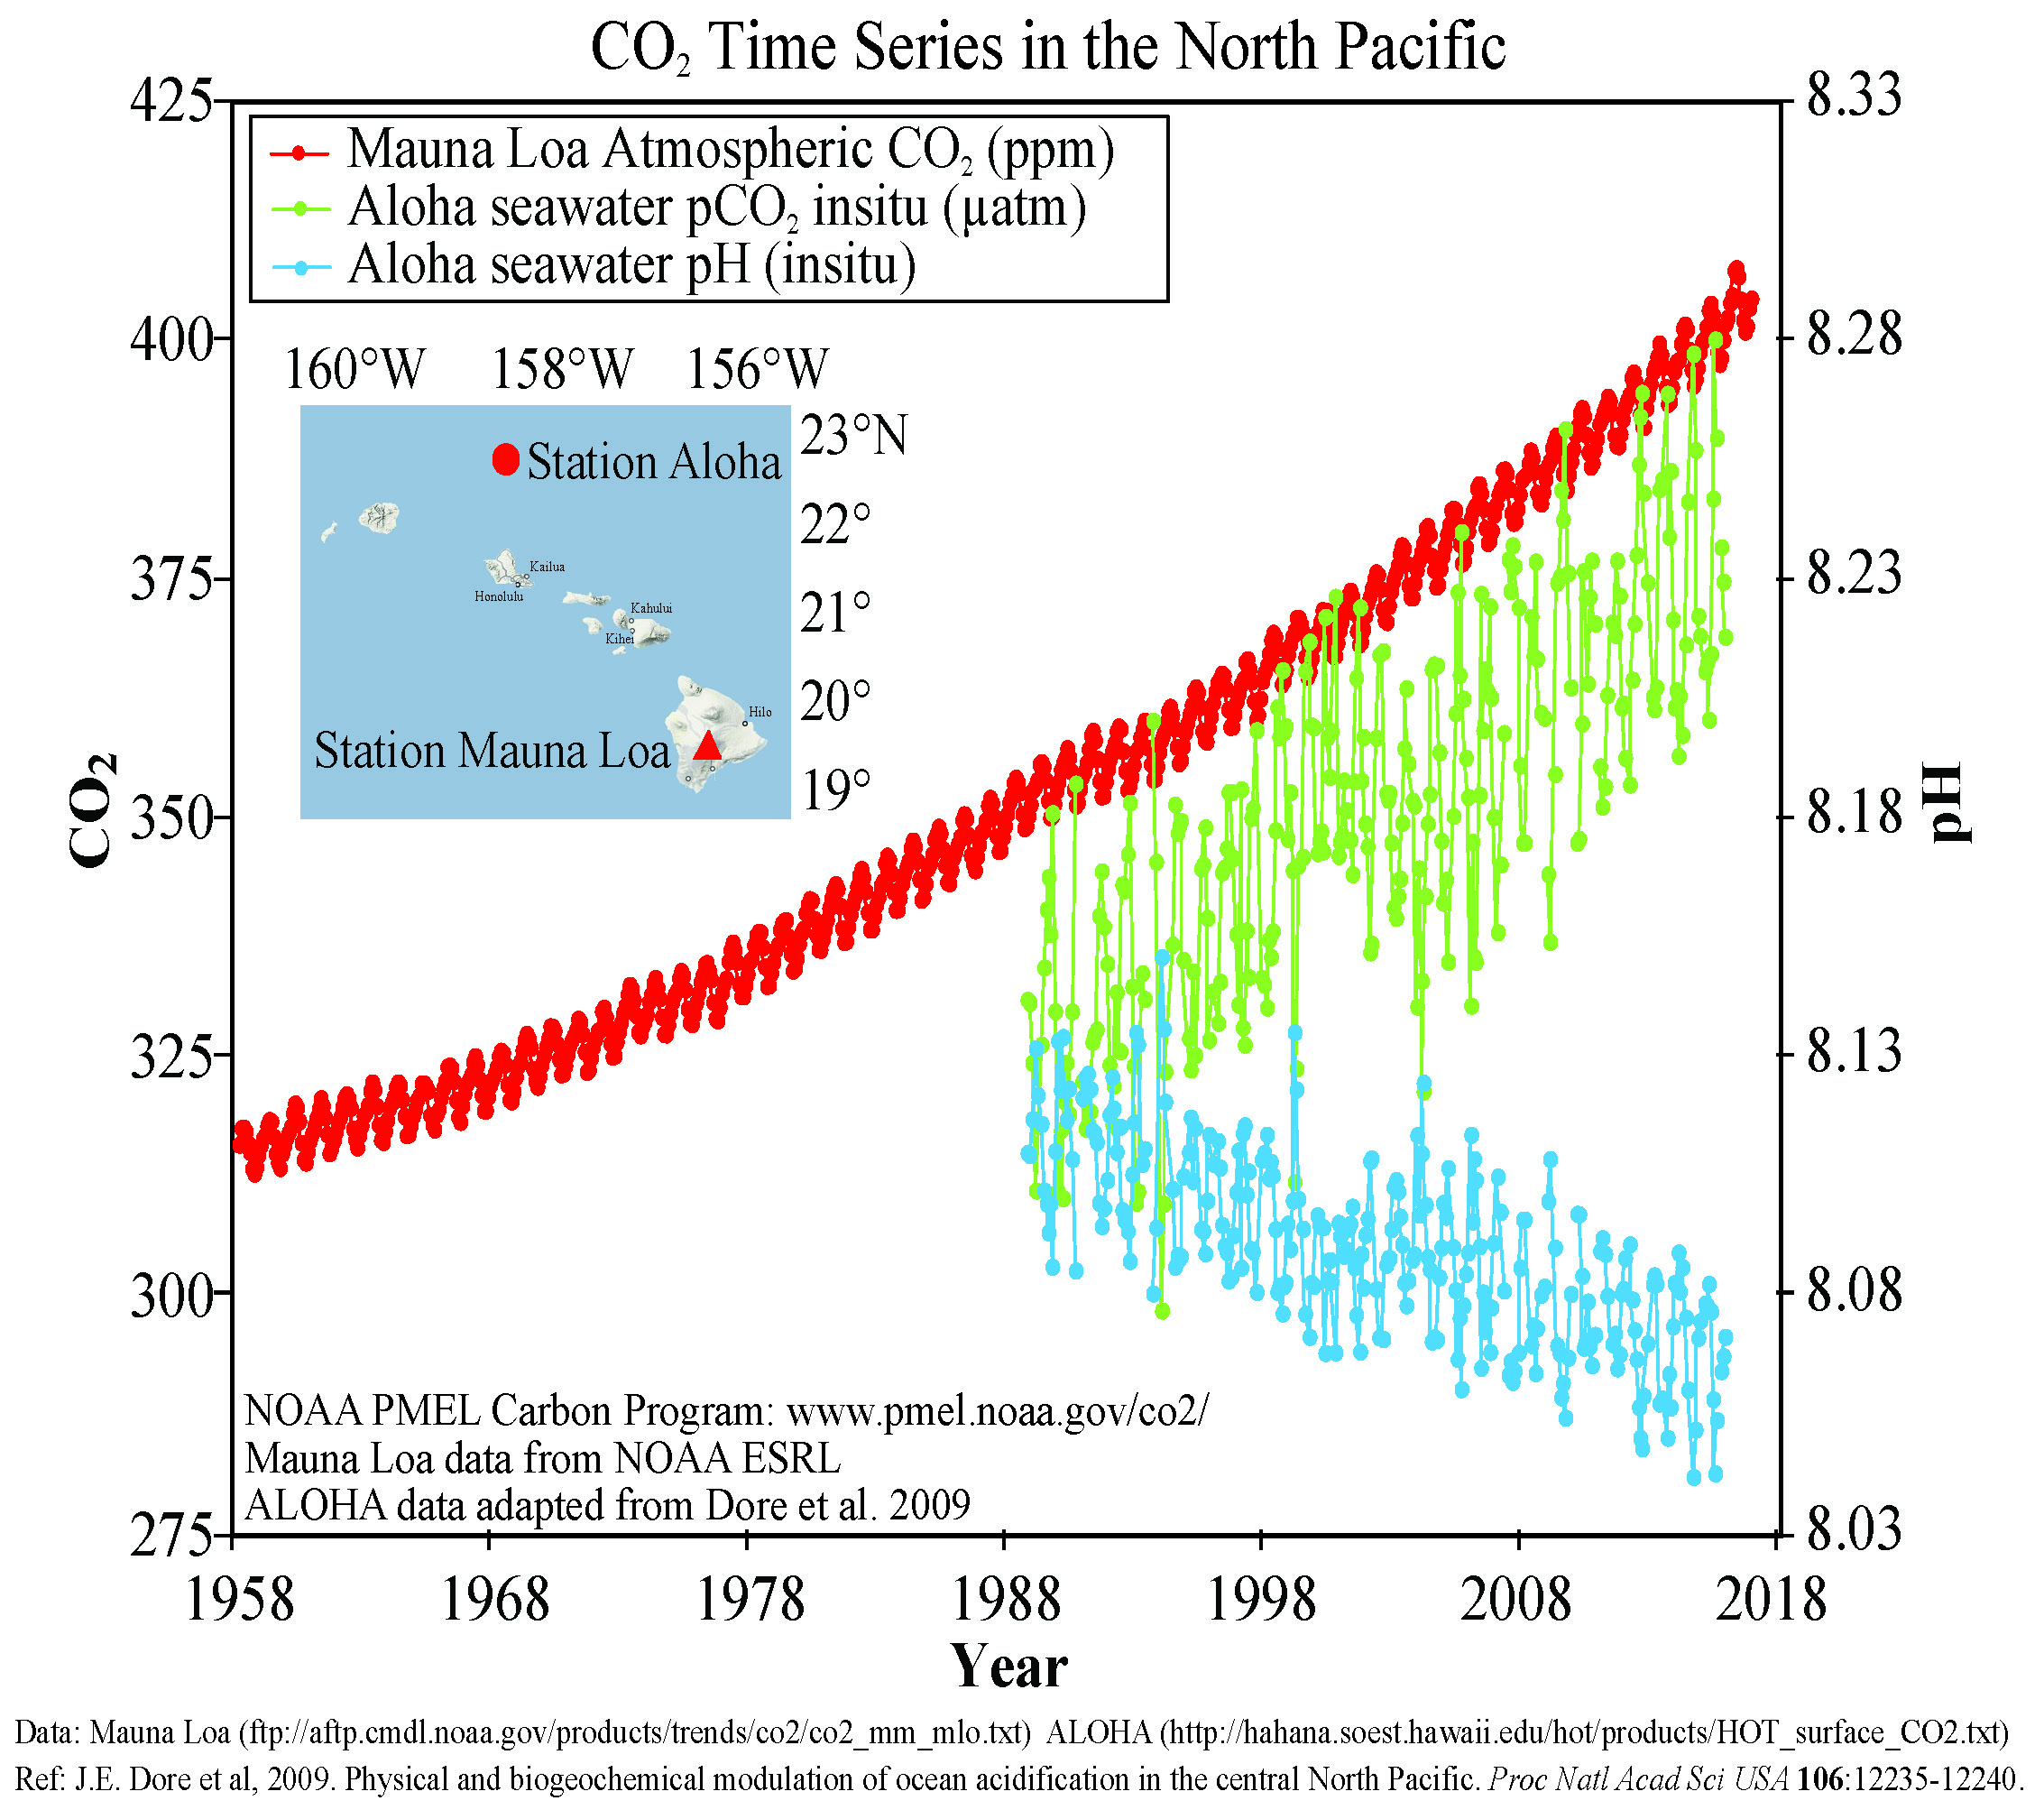
Impact of rising atmospheric CO₂ on ocean pH
In 2016, atmospheric CO₂ was 403 ppm
Pre-industrial ocean pH was 8.2
Pre-industrial atmospheric CO₂ was 290 ppm
In 2016, ocean pH was 8.06
https://www.researchgate.net/post/Is_the_Mauna_Loa_Observatory_Hawaii_records_for_C02_representative_of_Global_CO2_for_the_Earth_Atmosphere_Are_they_the_proof_of_GLOBAL_WARMING

Slide 7
Impact of rising atmospheric CO₂ on ocean pH
In 2022, atmospheric CO₂ is 419 ppm
Pre-industrial ocean pH was 8.2
Pre-industrial atmospheric CO₂ was 290 ppm
In 2016, ocean pH is 8.04
https://www.researchgate.net/post/Is_the_Mauna_Loa_Observatory_Hawaii_records_for_C02_representative_of_Global_CO2_for_the_Earth_Atmosphere_Are_they_the_proof_of_GLOBAL_WARMING

Slide 8
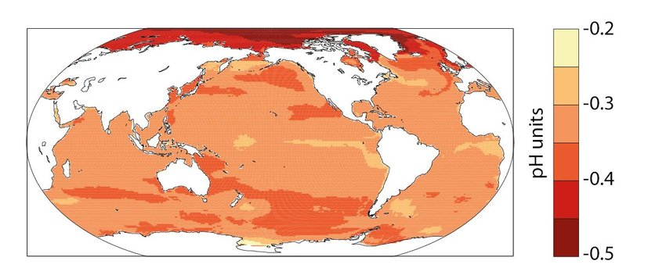
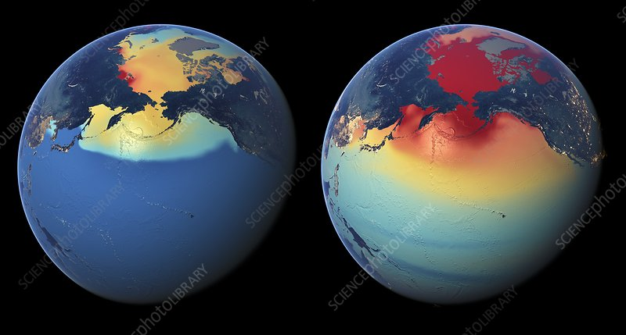
Which oceans are acidifying? It seems the Arctic is getting hit the most
https://www.researchgate.net/publication/328166919_A_new_climate_change_vulnerability_assessment_for_fisheries_and_aquaculture/figures?lo=1
Drop in pH
https://www.sciencephoto.com/media/684079/view

Slide 9
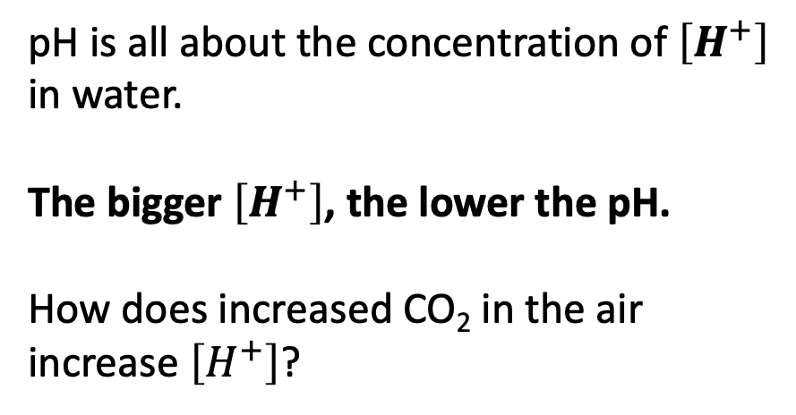
But how does that relate to the atmosphere? First, let’s assert that [H+] is proportional to the concentration of CO2 in the water,
[H+] = K [CO2]_w (2)
Relationship between pH and atmospheric CO₂
pH is all about the concentration of $\left[H^{+}\right]$ in water.
The bigger $\left[H^{+}\right]$, the lower the pH.
How does increased CO₂ in the air increase $\left[H^{+}\right]$?

Slide 10

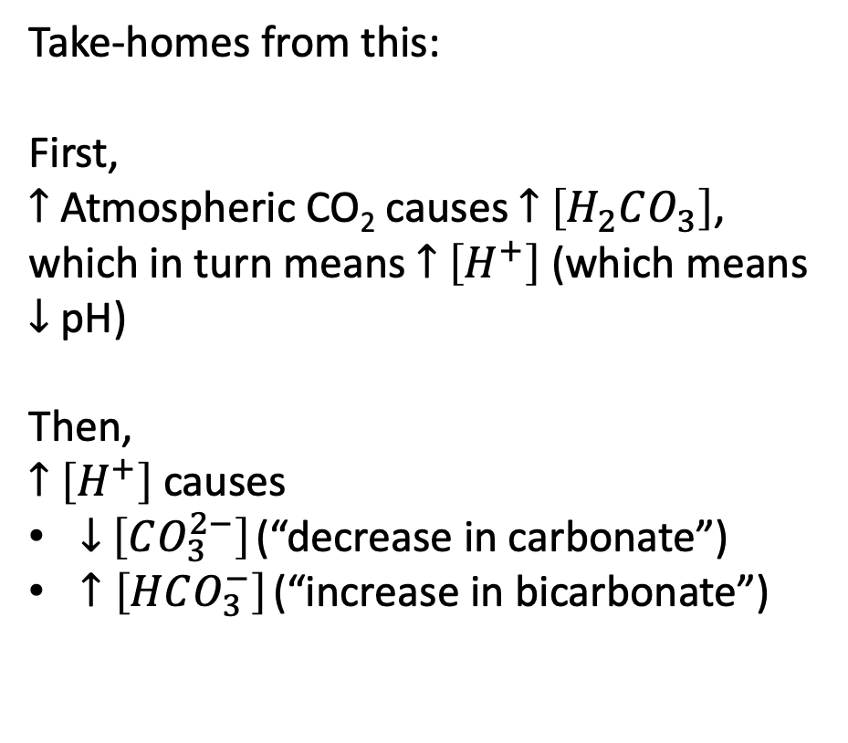



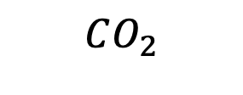



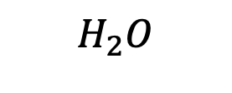


But how does that relate to the atmosphere? First, let’s assert that [H+] is proportional to the concentration of CO2 in the water,
[H+] = K [CO2]_w (2)
Cascade of carbonate reactions
Air
$$CO_{2}$$
Take-homes from this:
First,
$↑$ Atmospheric CO₂ causes $↑$ $\left[H_{2}CO_{3}\right]$, which in turn means $↑$ $\left[H^{+}\right]$ (which means $↓$ pH)
Then,
$↑$ $\left[H^{+}\right]$ causes
$↓$ $\left[CO_{3}^{2−}\right]$ (“decrease in carbonate”)
$↑\left[HCO_{3}^{−}\right]$ (“increase in bicarbonate”)
$$H_{2}O$$
$$H_{2}O$$
Oceans
$H_{2}CO_{3}$
$$H^{+}$$
$$H^{+}$$
$$HCO_{3}^{−}$$
$${Ca}^{2+}$$
$$CO_{3}^{2−}$$
Sea floor
$$CaCO_{3}$$
$$CaCO_{3}^{}$$

Slide 11
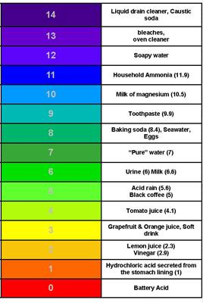
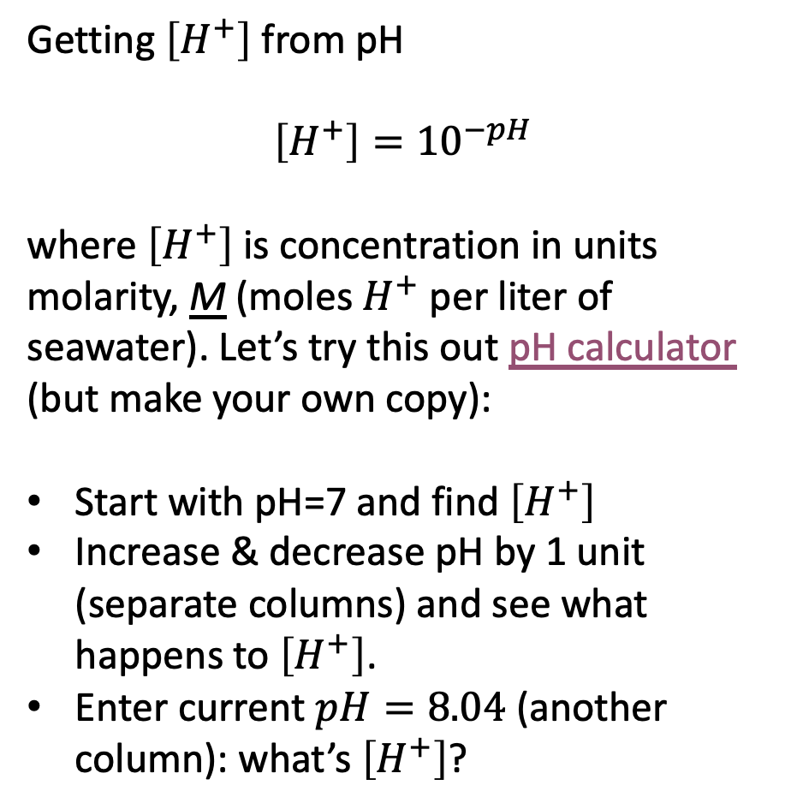




pH is a logarithmic scale
Getting $\left[H^{+}\right]$ from pH
$$\left[H^{+}\right]={10}^{−pH}$$
where $\left[H^{+}\right]$is concentration in units molarity, M (moles $H^{+}$ per liter of seawater). Let’s try this out pH calculator (but make your own copy):
Start with pH=7 and find $\left[H^{+}\right]$
Increase & decrease pH by 1 unit (separate columns) and see what happens to $\left[H^{+}\right]$.
Enter current $pH=8.04$ (another column): what’s $\left[H^{+}\right]$?
$$\left[H^{+}\right] =$$
${10}^{−8}$ M
${10}^{−7}$ M
${10}^{−6}$ M

Slide 12
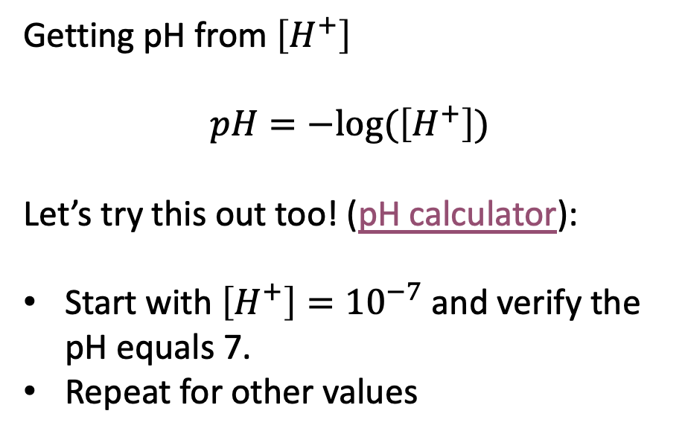
pH is a logarithmic scale
Getting pH from $\left[H^{+}\right]$
$$pH=−log⁡(\left[H^{+}\right])$$
Let’s try this out too! (pH calculator):
Start with $\left[H^{+}\right]={10}^{−7}$ and verify the pH equals 7.
Repeat for other values
$$\left[H^{+}\right] =$$
${10}^{−8}$ M
${10}^{−7}$ M
${10}^{−6}$ M

Slide 13
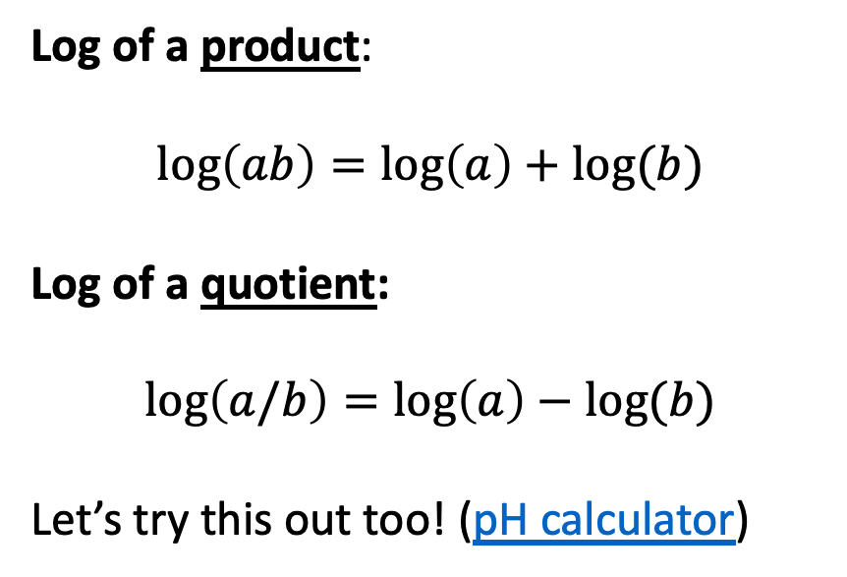

Log identities we’ll need going forward
Log of a product:
$$\log\left(ab\right)=\log\left(a\right)+log⁡(b)$$
Log of a quotient:
$$\log\left(a/b\right)=\log\left(a\right)−log⁡(b)$$
Let’s try this out too! (pH calculator)
$$\left[H^{+}\right] =$$
${10}^{−8}$ M
${10}^{−7}$ M
${10}^{−6}$ M

